Slide 1
Lending club case study
Summary of findings
Rahul Sinha

Slide 2
PURPOSE
Using EDA to evaluate risk in lending loans to the potential customers.
Figure out potential customers for profitability.

Slide 3
Business understanding
You work for a consumer finance company which specialises in lending various types of loans to urban customers. When the company receives a loan application, the company has to make a decision for loan approval based on the applicant’s profile. Two types of risks are associated with the bank’s decision:
If the applicant is likely to repay the loan, then not approving the loan results in a loss of business to the company.
If the applicant is not likely to repay the loan, i.e. he/she is likely to default, then approving the loan may lead to a financial loss for the company.
The company wants to understand the driving factors (or driver variables) behind loan default, i.e. the variables which are strong indicators of default. The company can utilise this knowledge for its portfolio and risk assessment.

Slide 4
Steps taken in analysis
Data understanding
Data cleansing
NaNs removal
Single value columns removal
Removal of columns adding no value due to be distinctive nature
Final data for analysis
Outliers treatment
Univariate analysis
Bivariate analysis
Recommendations

Slide 5
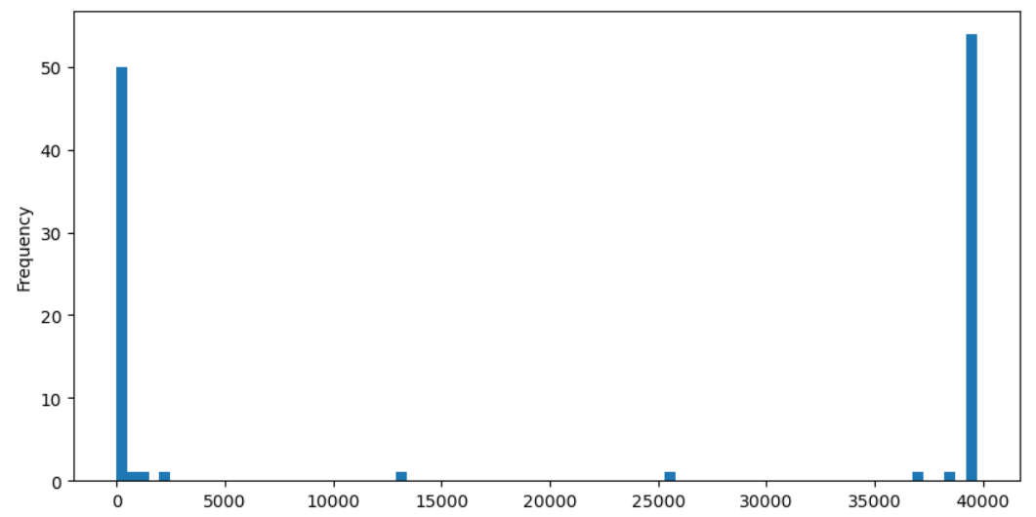
Data understanding
Available data was checked for nulls, single values, duplicate values and outliers.
Showing null columns in histogram

Slide 6
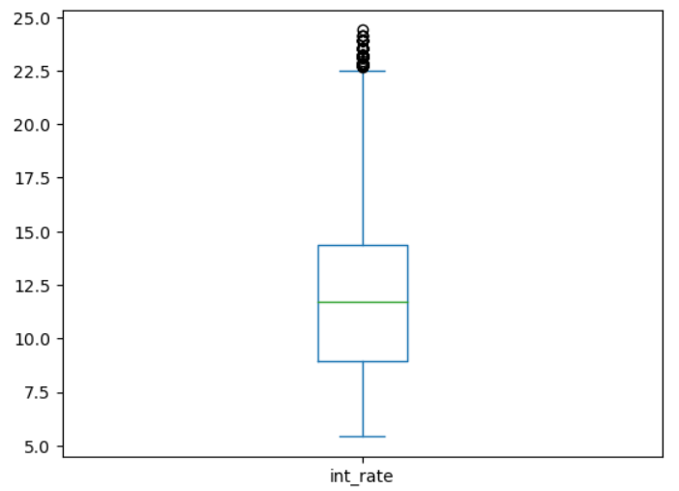
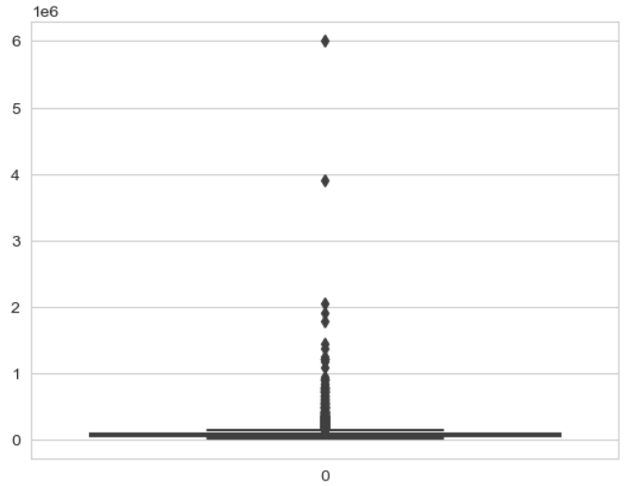
Outliers
Outliers in interest rate
Outliers in annual income

Slide 7
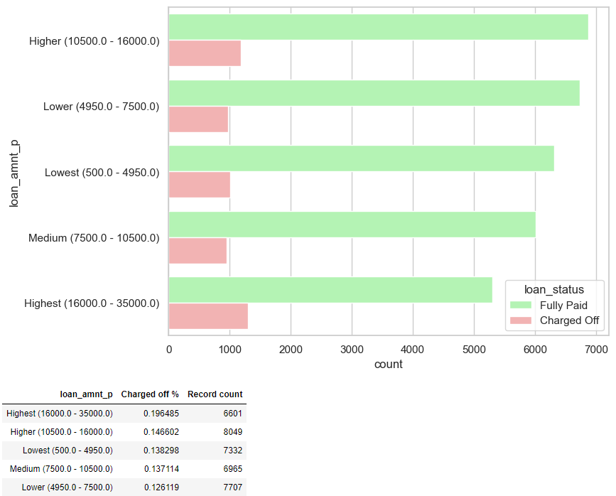
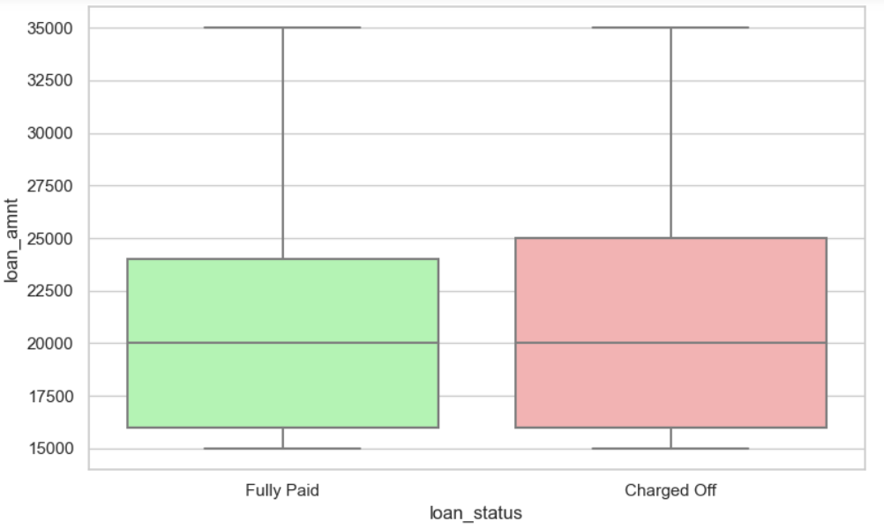
Loan amount vs loan status
Higher the loan amount more likely to be charged off

Slide 8
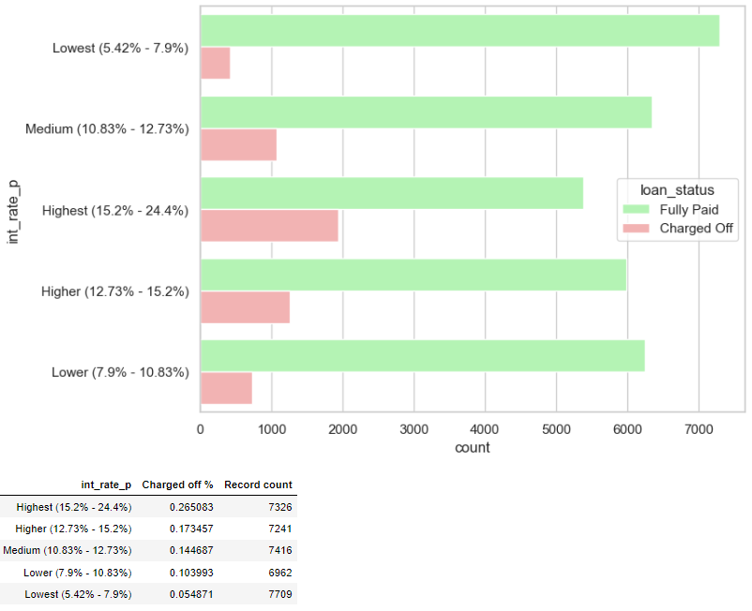
Interest rates
Higher interest rates more likely to be charged off

Slide 9
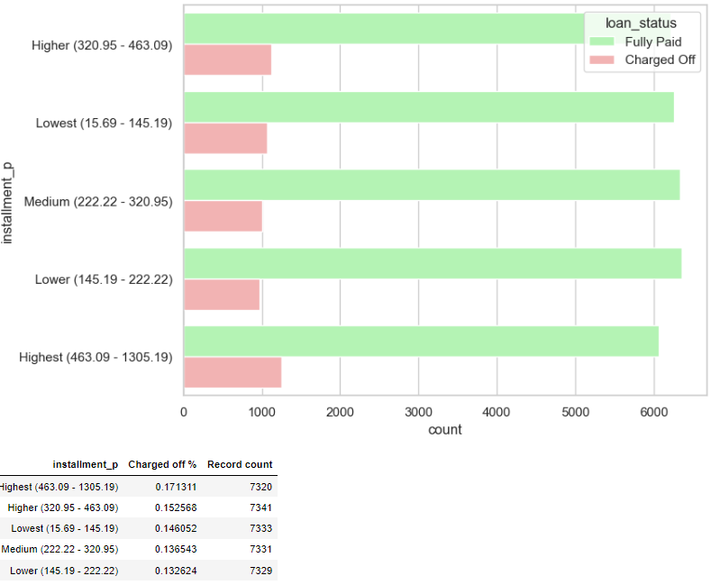
Installment amount
Higher installment amount more likely to be charged off

Slide 10
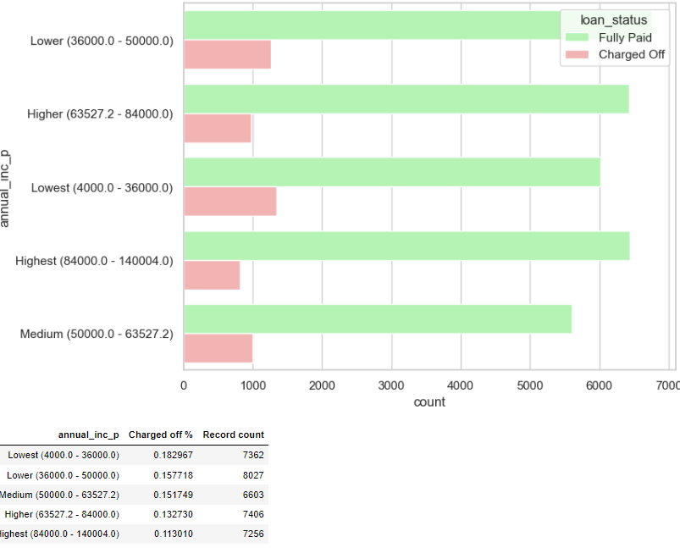
Annual income
Higher annual income insures higher chances of loan repayment

Slide 11
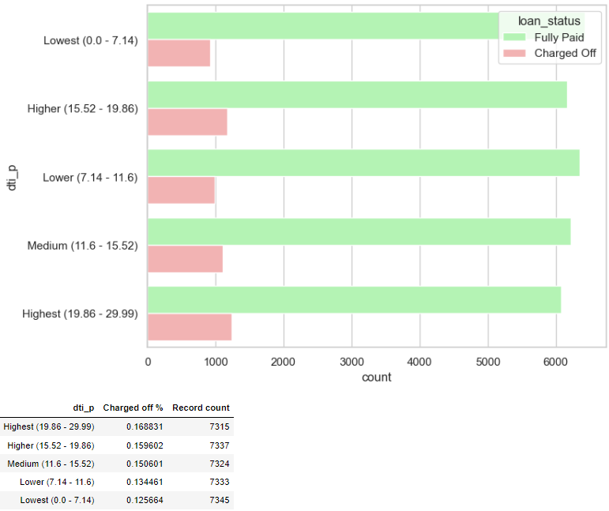
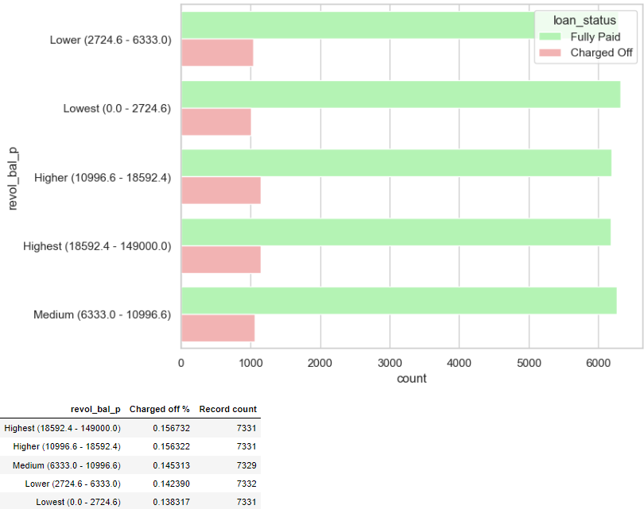
DTI & Revolving balance
Higher DTI & revolving balance higher chances of charged-off

Slide 12
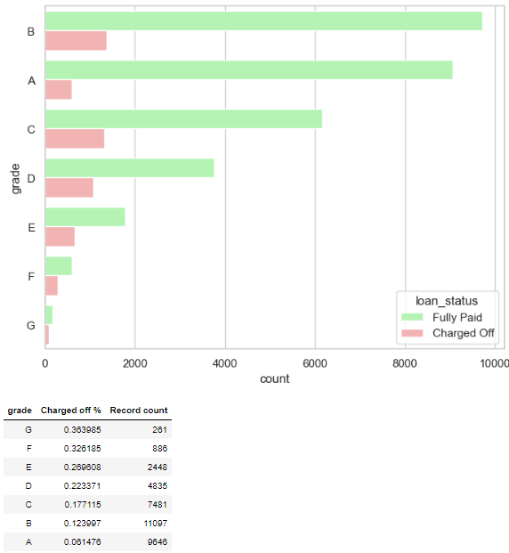
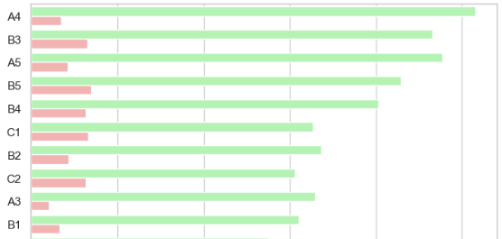
Grade and Sub-grade
The G3 and F5 sub categories have above 40% default rate. This field is a clear indicator of the default percent.
D, E, F and G have very high default rate

Slide 13
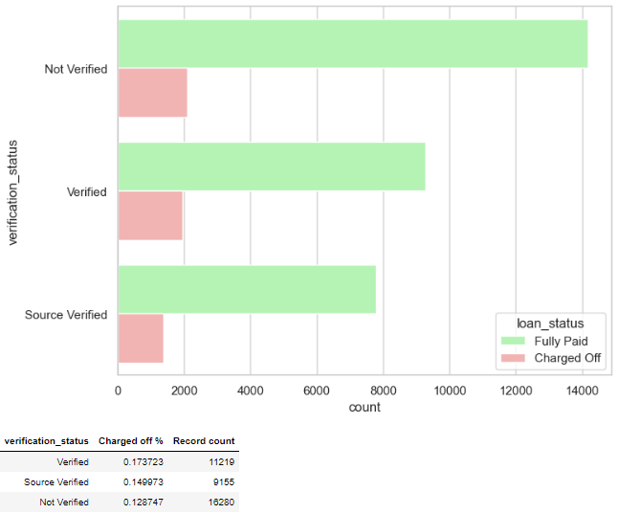
VERIFICATION
verified customers showing more defaults so verification has a flaw

Slide 14
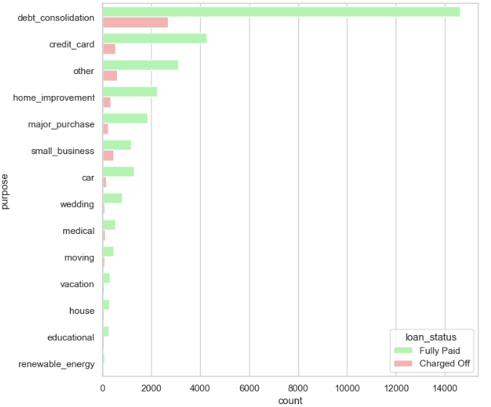
Purpose
small business purpose, Renewable and Education loan has maximum defaults

Slide 15
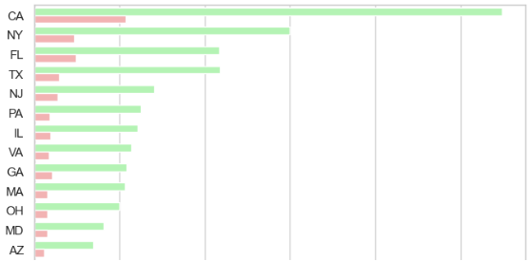
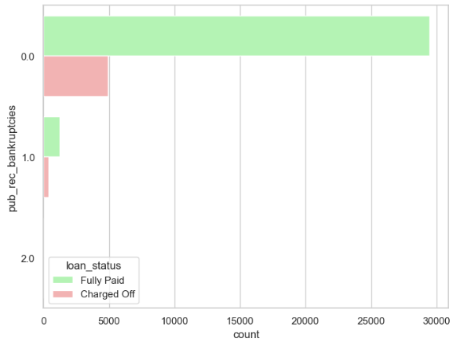
Address state & Bankruptcy
From the above table we can see that the some of the risky states are NE, NV, SD, AK, FL, MO
Higher the number of public bankruptcy records, bigger the chance of defaulting the loan

Slide 16
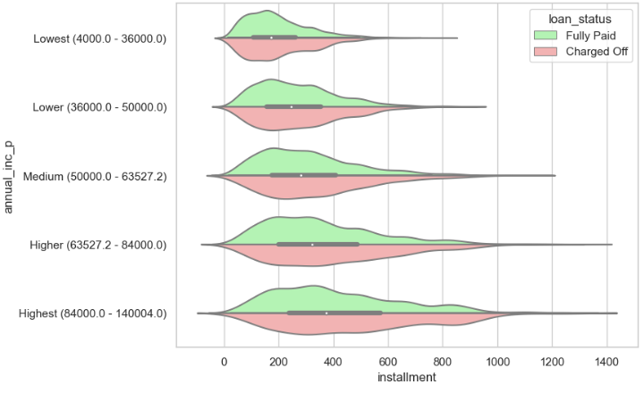
Bivariate analysis
Above figure shows that for higher installments for any income group have more number of defaults

Slide 17
Recommendations
Applicant with loan amount more than 10k are more likely to be a risk.
Loans with Interest rates more than 12% are under risk.
Installment amount more than 320/- is likely to be a risk.
Annual income more than 36k mostly ensures good repayment chances.
DTI more than 15 and revolving balance more than 13k is under risk.
Grades D, E, F, G and G3, F5 have default percent more than 40. It is a clear risk.
Verified customer showing higher defaulters which is a sign of ill verification process.
Loans for education, small business and renewable is under risk.
Risky states are NE, NV, SD, AK, FL, MO from default point of view.

